Slide 1
Cryptography and Network Security Chapters
by William Stallings
Lecture slides by Lawrie Brown
Edited by Nishant Doshi
Notes:
Lecture slides by Lawrie Brown for “Cryptography and Network Security”, 5/e, by William Stallings, briefly reviewing the text outline from Ch 0, and then presenting the content from Chapter 1 – “Introduction”.

Slide 2
Unit-2
Stream ciphers and block ciphers
Block Cipher structure
Data Encryption standard (DES)
Design principles of block cipher
AES with structure
AES Transformation functions
Key expansion
Notes:
X.800 and RFC 2828
International Telecommunication Union (ITU)

Slide 3
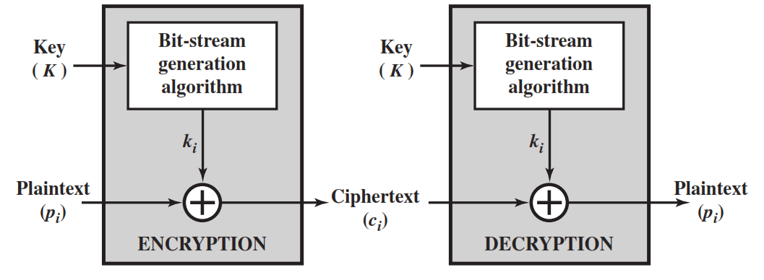
Stream Cipher
A stream cipher is one that encrypts a digital data stream one bit or one byte at a time.
Examples of classical stream ciphers are Autokeyed Vigenère cipher ,A5/1, RC4 and Vernam cipher.

Slide 4
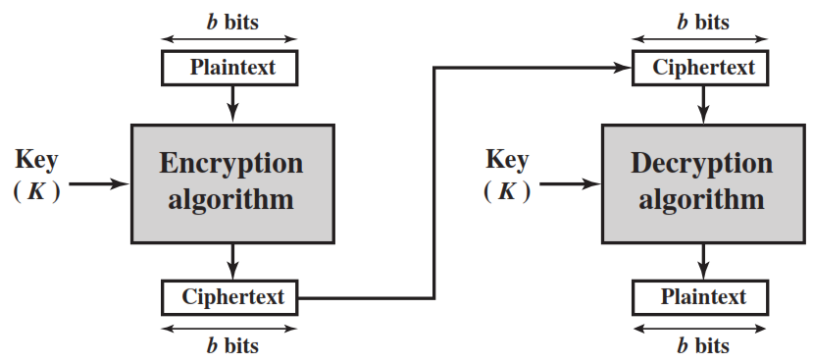
Block Cipher
A block cipher is one in which a block of plaintext is treated as a whole and used to produce a ciphertext block of equal length.
Typically, a block size of 64 or 128 bits is used.
Examples are Feistel Cipher, DES, Triple DES and AES

Slide 5
Diffusion and Confusion
Diffusion hides the relationship between the ciphertext and the plaintext.
This is achieved by having each plaintext digit affect the value of many ciphertext digits.
Confusion hides the relationship between the ciphertext and the key.
This is achieved by the use of a complex substitution algorithm.

Slide 6
Plaintext (2w bits)
Feistel Cipher Structure Or Block Cipher Structure
L₀
w bits
w bits
R₀
Round 1
K₁
F
L₁
R₁
Round i
K_{i}
F
L_{i}
R_{i}
Round n
K_{n}
L_{n}
R_{n}
F
L_{n+1}
R_{n+1}
L_{n}
R_{n}
Ciphertext (2w bits)

Slide 7
Feistel Cipher Structure
Input plaintext block of length 2w bits
key K = n bits , Sub-keys: K₁, K₂, …, K_{n} (Derived from K)
All rounds have the same structure.
A substitution is performed by taking exclusive-OR on left half(Li) of the data and the output of round function F which has inputs right half(Ri) and sub key ki.
A permutation is performed that consists of interchange of two halves of data.
This structure is called Substitution-Permutation Network (SPN)

Slide 8
Feistel Network Factors
Block size: Common block size of 64-bit. However, the new algorithms uses a 128-bit, 256-bit block size.
Key size: Key sizes of 64 bits or less are now widely considered to be insufficient, These days at least 128 bit, more better, e.g. 192 or 256 bit
Number of rounds: A typical size is 16 rounds.
Round function F: Again, greater complexity generally means greater resistance to cryptanalysis.
Subkey generation algorithm: Greater complexity in this algorithm should lead to greater difficulty of cryptanalysis.

Slide 9
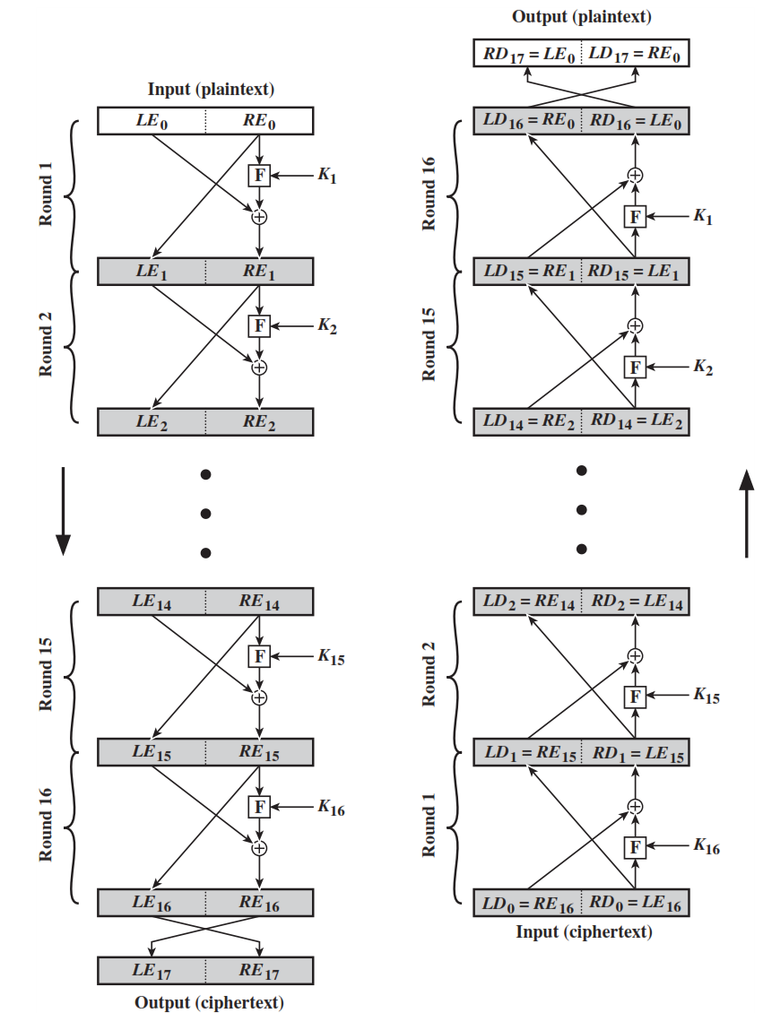





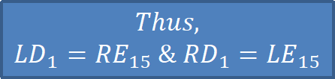

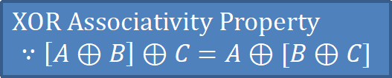
Feistel Encryption & Decryption
Prove that o/p of first round of Decryption is equal to 32-bit swap of i/p of 16th round of Encryption
LD₁=RE₁₅ & RD₁=LE₁₅
On Encryption Side:
$${LE}_{16}={RE}_{15}$$
$${RE}_{16}={LE}_{15} ⊕F({RE}_{15},K_{16})$$
On Decryption Side:
$${LD}_{1}={RD}_{0}={LE}_{16}={RE}_{15}$$
$${RD}_{1}={LD}_{0} ⊕F\left({RD}_{0},K_{16}\right)$$
$$={RE}_{16} ⊕F\left({RE}_{15},K_{16}\right)$$
$$={[LE}_{15} ⊕F\left({RE}_{15},K_{16}\right)] ⊕F\left({RE}_{15},K_{16}\right)$$
XOR Associativity Property
$$∵\left[A⊕B\right]⊕C=A⊕[B⊕C]$$
$$Thus,$$
$${LD}_{1}={RE}_{15} \&{ RD}_{1}={LE}_{15}$$

Slide 10
Data Encryption Standard (DES)
Type: Block Cipher
Block Size : 64-bit
Key Size: 64-bit, with only 56-bit effective
Number of Rounds: 16

Slide 11
64-bit plaintext
64-bit key
Initial Permutation
Permuted choice 1
64
56
Round 1
K₁
48
Permuted choice 2
56
Left circular shift
64
56
Round 2
K₂
48
Permuted choice 2
56
Left circular shift
Round 16
K₁₆
48
Permuted choice 2
56
Left circular shift
32-bit swap
64
DES Encryption Algorithm
Inverse
Initial Permutation
64-bit ciphertext

Slide 12
Initial Permutation IP
first step of the data computation
IP reorders the input data bits
even bits to LH half, odd bits to RH half
quite regular in structure (easy in h/w)
example:
Notes:
The initial permutation and its inverse are defined by tables, as shown in Stallings Tables 3.2a and 3.2b, respectively. The tables are to be interpreted as follows. The input to a table consists of 64 bits numbered left to right from 1 to 64. The 64 entries in the permutation table contain a permutation of the numbers from 1 to 64. Each entry in the permutation table indicates the position of a numbered input bit in the output, which also consists of 64 bits.
Note that the bit numbering for DES reflects IBM mainframe practice, and is the opposite of what we now mostly use - so be careful! Numbers from Bit 1 (leftmost, most significant) to bit 32/48/64 etc (rightmost, least significant).
For example, a 64-bit plaintext value of “675a6967 5e5a6b5a” (written in left & right halves) after permuting with IP becomes “ffb2194d 004df6fb”. Note that example values are specified using hexadecimal.

Slide 13
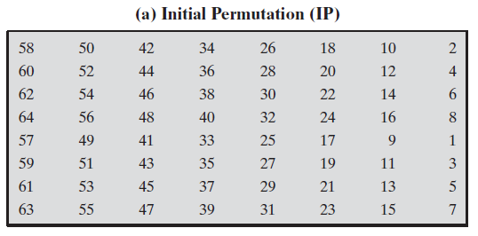

Slide 14
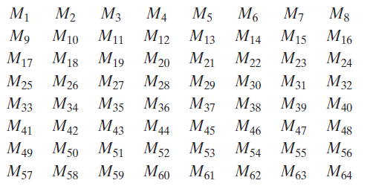
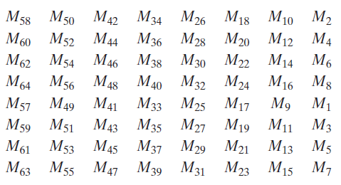

Slide 15
ODD :675A69675E5A6B5A
EVEN : 02468ACEECA86420
IP(675A6967 5E5A6B5A)
= (FFB2194D 004DF6FB)
02468ACEECA86420
(5A005A00 3CF03C0F)

Slide 17
Inverse Permutation
40 8 48 16

Slide 18
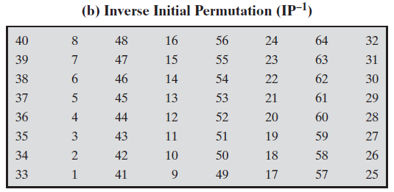

Slide 20
DES Encryption Algorithm (Cont…)
First, the 64-bit plaintext passes through an initial permutation (IP) that rearranges the bits to produce the permuted input.
This is followed by a phase consisting of sixteen rounds of the same function, which involves both permutation and substitution functions.
Finally, the preoutput is passed through a permutation that is the inverse of the initial permutation function, to produce the 64-bit ciphertext.
The 56-bit key is passed through a permutation function.
For each of the sixteen rounds, a subkey (K_{i}) is produced by the combination of a left circular shift and a permutation.

Slide 21
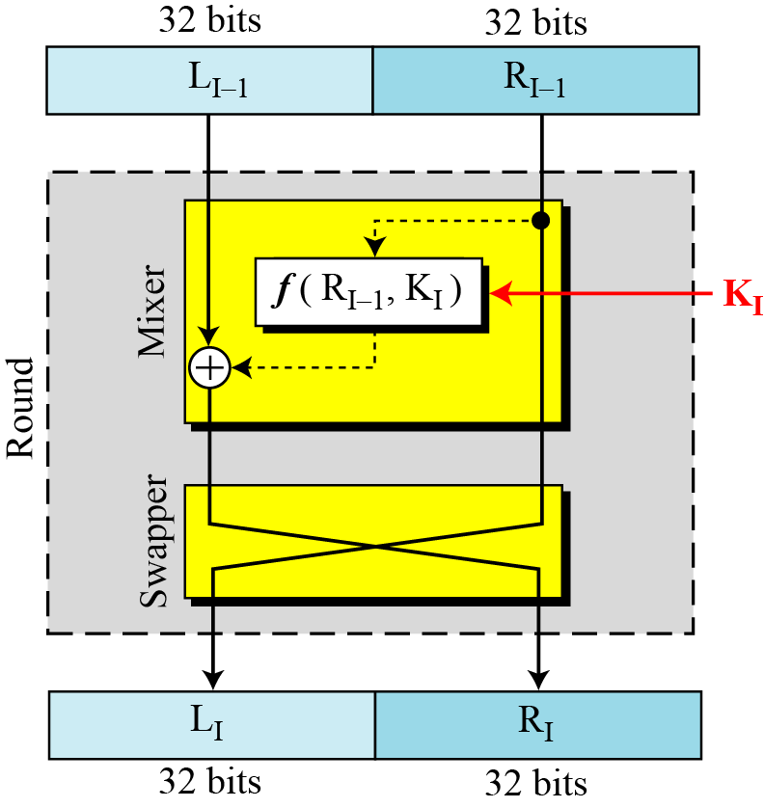
DES Single Round

Slide 22








32-bits
32-bits
28-bits
28-bits
$$L_{i−1}$$
$$R_{i−1}$$
$$C_{i−1}$$
$$D_{i−1}$$
Expansion/ permutation
(E table)
Left Shift
(S)
Left Shift
(S)
48
K_{i}
Permutation/ compression
(Permuted choice 2)
XOR
48
48
Substitution/choice
(S-box)
32
Permutation
(P)
32
XOR
$$L_{i}$$
$$R_{i}$$
$$C_{i}$$
$$D_{i}$$
Notes:
confusion step is the S-box substitution, while the diffusion step is where the output of the S-boxes is rearranged according to the P-box permutation rules.

Slide 23
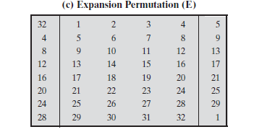
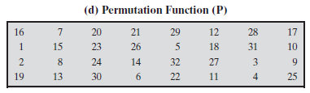

Slide 24
DES Single Round (Cont…)
Key Transformation
Permutation of selection of sub-key from original key
Expansion Permutation (E-table)
Right half is expanded from 32-bits to 48-bits
S-box Substitution
Accepts 48-bits from XOR operation and produce 32-bits using 8 substitution boxes (each S-boxes has a 6-bit i/p and 4-bit o/p).
P-Box Permutation
XOR and Swap

Slide 25
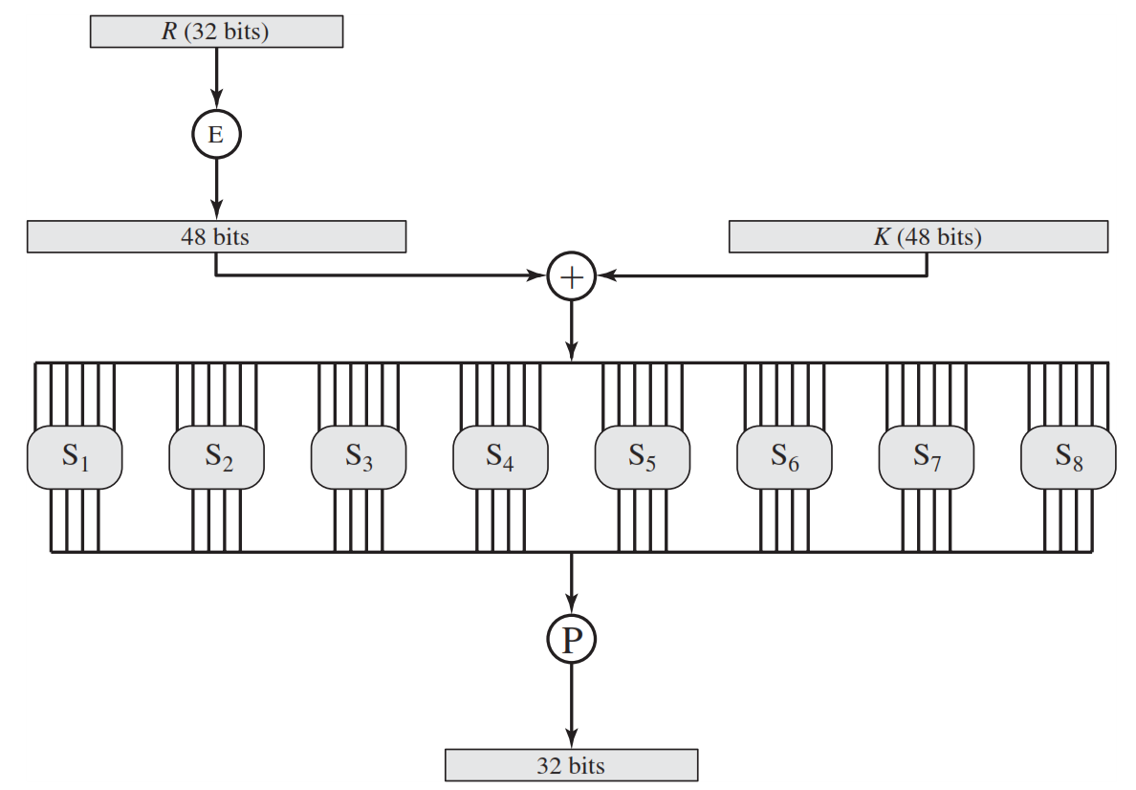
Role of S-box

Slide 26
Role of S-box (Cont…)
The outer two bits of each group select one row of an S-box.
Inner four bits selects one column of an S-box.
S-box 1
Example:
Input
0 | 1 | 1 | 0 | 0 | 1
Output
1 | 0 | 0 | 1
Row
Column

Slide 27
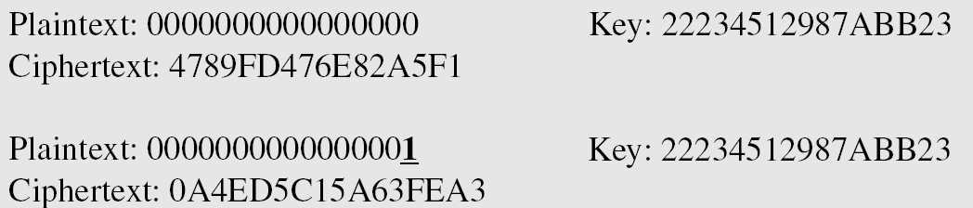
Avalanche Effect
Desirable property of any encryption algorithm is that a change in one bit of the plaintext or of the key should produce a change in many bits of cipher text.
DES performs strong avalanche effect.
Although the two plaintext blocks differ only in the rightmost bit, the ciphertext blocks differ in 29 bits.
This means that changing approximately 1.5 % of the plaintext creates a change of approximately 45 % in the ciphertext.

Slide 28
Avalanche Effect
key desirable property of encryption alg
where a change of one input or key bit results in changing approx half output bits
making attempts to “home-in” by guessing keys impossible
DES exhibits strong avalanche
Notes:
A desirable property of any encryption algorithm is that a small change in either the plaintext or the key should produce a significant change in the ciphertext. In particular, a change in one bit of the plaintext or one bit of the key should produce a change in many bits of the ciphertext. If the change were small, this might provide a way to reduce the size of the plaintext or key space to be searched. DES exhibits a strong avalanche effect, as may be seen in Stallings Table 3.5.

Slide 29
Strength of DES – Key Size
56-bit keys have 2⁵⁶ = 7.2 x 10¹⁶ values
brute force search looks hard
recent advances have shown is possible
in 1997 on Internet in a few months
in 1998 on dedicated h/w (EFF) in a few days
in 1999 above combined in 22hrs!
still must be able to recognize plaintext
must now consider alternatives to DES
Notes:
Since its adoption as a federal standard, there have been lingering concerns about the level of security provided by DES in two areas: key size and the nature of the algorithm.
With a key length of 56 bits, there are 2⁵⁶ possible keys, which is approximately 7.2*10¹⁶ keys. Thus a brute-force attack appeared impractical.
However DES was finally and definitively proved insecure in July 1998, when the Electronic Frontier Foundation (EFF) announced that it had broken a DES encryption using a special-purpose "DES cracker" machine that was built for less than $250,000. The attack took less than three days. The EFF has published a detailed description of the machine, enabling others to build their own cracker [EFF98].
There have been other demonstrated breaks of the DES using both large networks of computers & dedicated h/w, including:
- 1997 on a large network of computers in a few months
- 1998 on dedicated h/w (EFF) in a few days
- 1999 above combined in 22hrs!
It is important to note that there is more to a key-search attack than simply running through all possible keys. Unless known plaintext is provided, the analyst must be able to recognize plaintext as plaintext.
Clearly must now consider alternatives to DES, the most important of which are AES and triple DES.

Slide 30
Strength of DES – Analytic Attacks
now have several analytic attacks on DES
these utilise some deep structure of the cipher
by gathering information about encryptions
can eventually recover some/all of the sub-key bits
if necessary then exhaustively search for the rest
generally these are statistical attacks
differential cryptanalysis
linear cryptanalysis
related key attacks
Notes:
Another concern is the possibility that cryptanalysis is possible by exploiting the characteristics of the DES algorithm. The focus of concern has been on the eight substitution tables, or S-boxes, that are used in each iteration. These techniques utilise some deep structure of the cipher by gathering information about encryptions so that eventually you can recover some/all of the sub-key bits, and then exhaustively search for the rest if necessary. Generally these are statistical attacks which depend on the amount of information gathered for their likelihood of success. Attacks of this form include differential cryptanalysis. linear cryptanalysis, and related key attacks.

Slide 31
Strength of DES – Timing Attacks
attacks actual implementation of cipher
use knowledge of consequences of implementation to derive information about some/all subkey bits
specifically use fact that calculations can take varying times depending on the value of the inputs to it
particularly problematic on smartcards
Notes:
We will discuss timing attacks in more detail later, as they relate to public-key algorithms. However, the issue may also be relevant for symmetric ciphers. A timing attack is one in which information about the key or the plaintext is obtained by observing how long it takes a given implementation to perform decryptions on various ciphertexts. A timing attack exploits the fact that an encryption or decryption algorithm often takes slightly different amounts of time on different inputs. The AES analysis process has highlighted this attack approach, and showed that it is a concern particularly with smartcard implementations, though DES appears to be fairly resistant to a successful timing attack.

Slide 32
Block Cipher Design
basic principles still like Feistel’s in 1970’s
number of rounds
more is better, exhaustive search best attack
function f:
provides “confusion”, is nonlinear, avalanche
have issues of how S-boxes are selected
key schedule
complex subkey creation, key avalanche
Notes:
The cryptographic strength of a Feistel cipher derives from three aspects of the design: the number of rounds, the function F, and the key schedule algorithm. Briefly discuss these.
The greater the number of rounds, the more difficult it is to perform cryptanalysis, even for a relatively weak F. In general, the criterion should be that the number of rounds is chosen so that known cryptanalytic efforts require greater effort than a simple brute-force key search attack. This criterion is attractive because it makes it easy to judge the strength of an algorithm and to compare different algorithms.
The function F provides the element of confusion in a Feistel cipher, want it to be difficult to “unscramble” the substitution performed by F. One obvious criterion is that F be nonlinear. The more nonlinear F, the more difficult any type of cryptanalysis will be. We would like it to have good avalanche properties, or even the strict avalanche criterion (SAC). Another criterion is the bit independence criterion (BIC). One of the most intense areas of research in the field of symmetric block ciphers is that of S-box design. Would like any change to the input vector to an S-box to result in random-looking changes to the output. The relationship should be nonlinear and difficult to approximate with linear functions.
A final area of block cipher design, and one that has received less attention than S-box design, is the key schedule algorithm. With any Feistel block cipher, the key schedule is used to generate a subkey for each round. Would like to select subkeys to maximize the difficulty of deducing individual subkeys and the difficulty of working back to the main key. The key schedule should guarantee key/ciphertext Strict Avalanche Criterion and Bit Independence Criterion.

Slide 33
Summary
have considered:
block vs stream ciphers
Feistel cipher design & structure
DES
details
strength
Differential & Linear Cryptanalysis
block cipher design principles
Notes:
Chapter 3 summary.

Slide 34
Chapter 5 –Advanced Encryption Standard
"It seems very simple."
"It is very simple. But if you don't know what the key is it's virtually indecipherable."
—Talking to Strange Men, Ruth Rendell
Notes:
Intro quote.

Slide 35
Origins
clear a replacement for DES was needed
have theoretical attacks that can break it
have demonstrated exhaustive key search attacks
can use Triple-DES – but slow, has small blocks
US NIST issued call for ciphers in 1997
15 candidates accepted in Jun 98
5 were shortlisted in Aug-99
Rijndael was selected as the AES in Oct-2000
issued as FIPS PUB 197 standard in Nov-2001
Notes:
The Advanced Encryption Standard (AES) was published by NIST (National Institute of Standards and Technology) in 2001. AES is a symmetric block cipher that is intended to replace DES as the approved standard for a wide range of applications. The AES cipher (& other candidates) form the latest generation of block ciphers, and now we see a significant increase in the block size - from the old standard of 64-bits up to 128-bits; and keys from 128 to 256-bits. In part this has been driven by the public demonstrations of exhaustive key searches of DES. Whilst triple-DES is regarded as secure and well understood, it is slow, especially in s/w. In a first round of evaluation, 15 proposed algorithms were accepted. A second round narrowed the field to 5 algorithms. NIST completed its evaluation process and published a final standard (FIPS PUB 197) in November of 2001. NIST selected Rijndael as the proposed AES algorithm. The two researchers who developed and submitted Rijndael for the AES are both cryptographers from Belgium: Dr. Joan Daemen and Dr.Vincent Rijmen.

Slide 36
The AES Cipher - Rijndael
designed by Rijmen-Daemen in Belgium
has 128/192/256 bit keys, 128 bit data
an iterative rather than feistel cipher
processes data as block of 4 columns of 4 bytes
operates on entire data block in every round
designed to be:
resistant against known attacks
speed and code compactness on many CPUs
design simplicity
Notes:
The Rijndael proposal for AES defined a cipher in which the block length and the key length can be independently specified to be 128,192,or 256 bits. The AES specification uses the same three key size alternatives but limits the block length to 128 bits. Rijndael is an academic submission, based on the earlier Square cipher, from Belgium academics Dr Joan Daemen and Dr Vincent Rijmen. It is an iterative cipher (operates on entire data block in every round) rather than feistel (operate on halves at a time), and was designed to have characteristics of: Resistance against all known attacks, Speed and code compactness on a wide range of platforms, & Design simplicity.

Slide 37
AES (Advanced Encryption Standard)
The Rijndael proposal for AES defined a cipher in which the block length and the key length can be independently specified to be 128, 192, or 256 bits.
AES designed to have characteristics
Resistance against all known attacks
Speed and code compactness on a wide range of platforms
Design simplicity
Key size (words/ bytes/ bits) | 4/16/128 | 6/24/192 | 8/32/256
Block size (words/ bytes/ bits) | 4/16/128 | 4/16/128 | 4/16/128
Round key size (words/ bytes/ bits) | 4/16/128 | 4/16/128 | 4/16/128
Number of Rounds | 10 | 12 | 14

Slide 38
AES (Advanced Encryption Standard)
Plaintext (128 bits)
AES
Key (128-256 bits)
Ciphertext (128 bits)

Slide 39
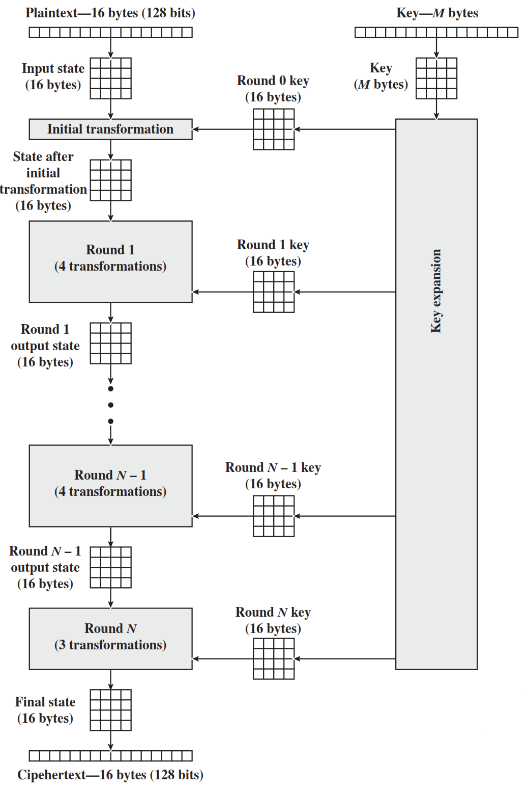
AES Structure
Initialization
Expand 16-byte key to get the actual key block to be used.
Initialize 16-byte plaintext block called as state.
XOR the state with the key block.
For each round
Apply S-box
Rotate rows of state
Mix columns
Add Round key: XOR the state with key block.

Slide 40
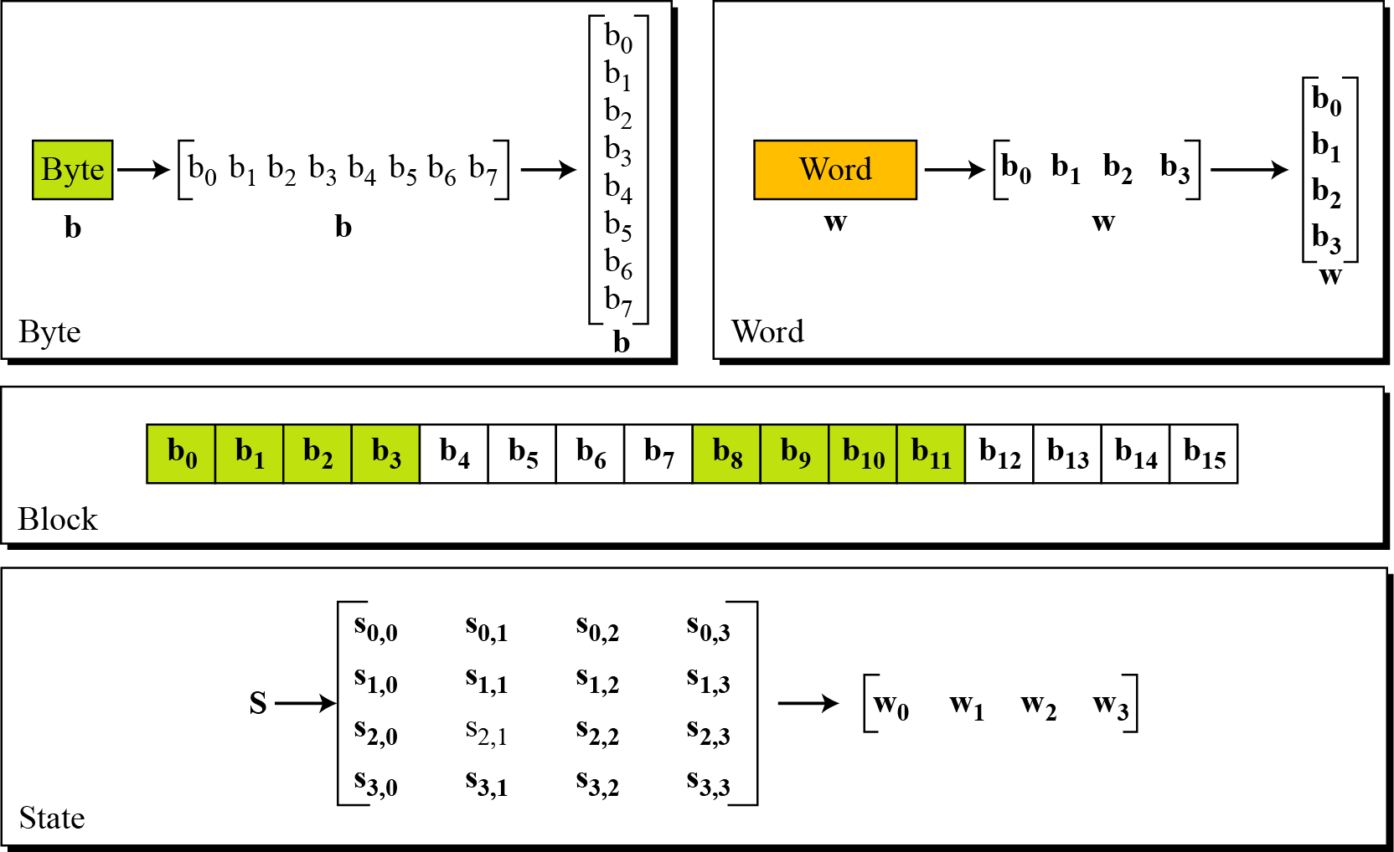
Data Units in AES

Slide 41
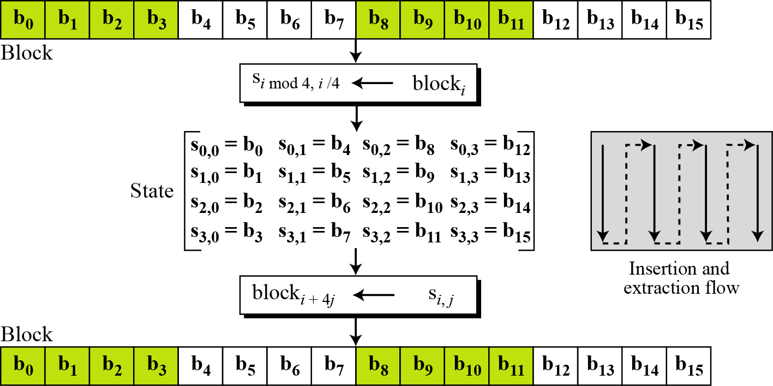
Block to State & State to Block

Slide 42
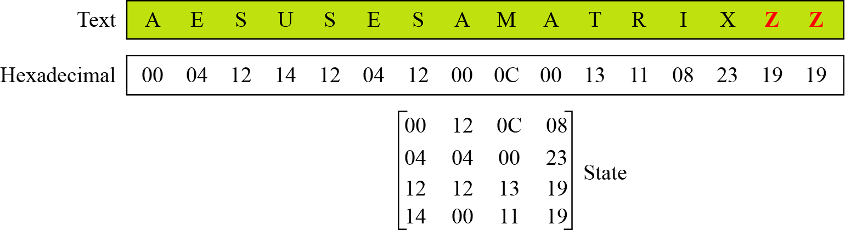
Plain Text to State

Slide 43
AES Structure
The first N-1 rounds consist of four distinct transformation functions.
SubBytes
The 16 input bytes are substituted using an S-box
ShiftRows
Each of the four rows of the matrix is shifted to the left
MixColumns
Each column of four bytes is now transformed using a special mathematical function.
AddRoundKey
The 16 bytes of the matrix are now considered as 128 bits and are XORed to the 128 bits of the round key.

Slide 44
The AES Cipher - Rijndael
designed by Rijmen-Daemen in Belgium
has 128/192/256 bit keys, 128 bit data
an iterative rather than feistel cipher
processes data as block of 4 columns of 4 bytes
operates on entire data block in every round
designed to be:
resistant against known attacks
speed and code compactness on many CPUs
design simplicity
Notes:
The Rijndael proposal for AES defined a cipher in which the block length and the key length can be independently specified to be 128,192,or 256 bits. The AES specification uses the same three key size alternatives but limits the block length to 128 bits. Rijndael is an academic submission, based on the earlier Square cipher, from Belgium academics Dr Joan Daemen and Dr Vincent Rijmen. It is an iterative cipher (operates on entire data block in every round) rather than feistel (operate on halves at a time), and was designed to have characteristics of: Resistance against all known attacks, Speed and code compactness on a wide range of platforms, & Design simplicity.

Slide 45
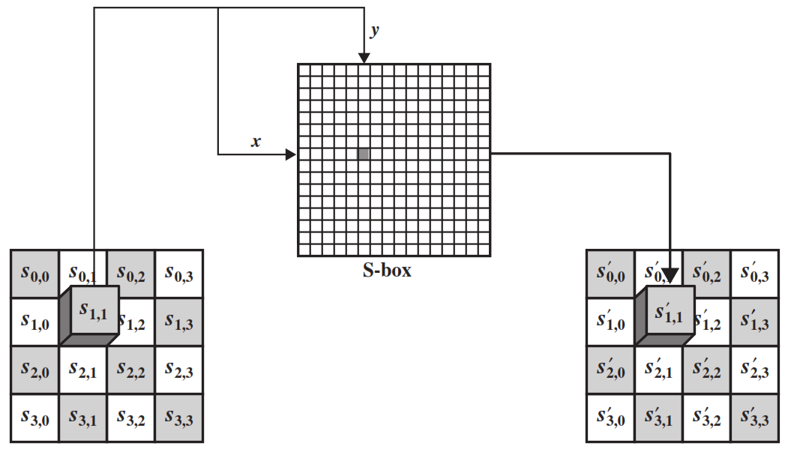
SubByte Transformation
The forward substitute byte transformation, called SubBytes, is a simple table lookup

Slide 46
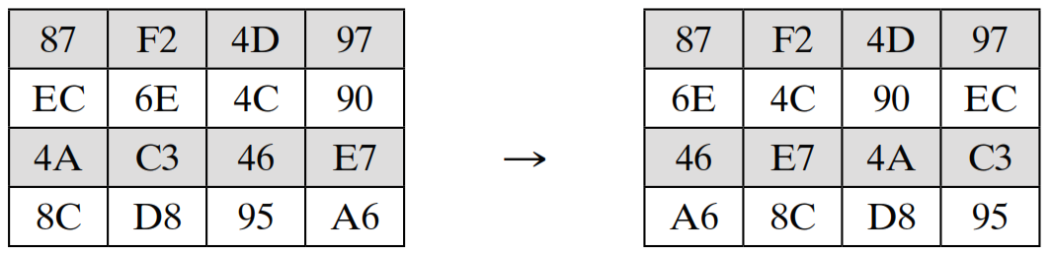
ShiftRows
The first row of State is not altered.
For the second row, a 1-byte circular left shift is performed.
For the third row, a 2-byte circular left shift is performed.
For the fourth row, a 3-byte circular left shift is performed.

Slide 47
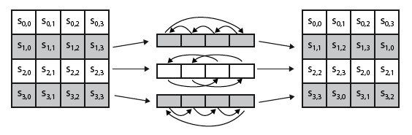

Shift Rows
Notes:
Stalling Figure 5.7a illustrates the Shift Rows permutation. Then show an example of ShiftRows from the text.

Slide 48
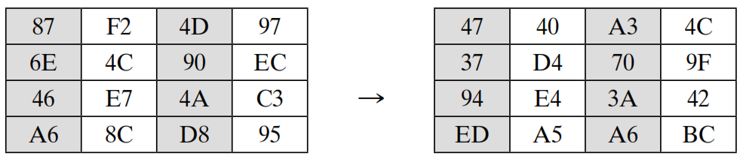
MixColumns
Each byte of a column is mapped into a new value that is a function of all four bytes in that column.

Slide 49
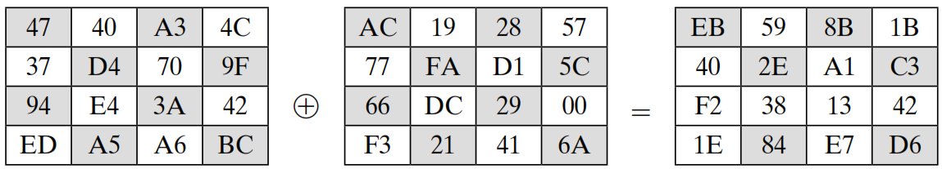
AddRoundKey
In the forward add round key transformation, the 128 bits of State are bitwise XORed with the 128 bits of the round key.
State
Round Key

Slide 50
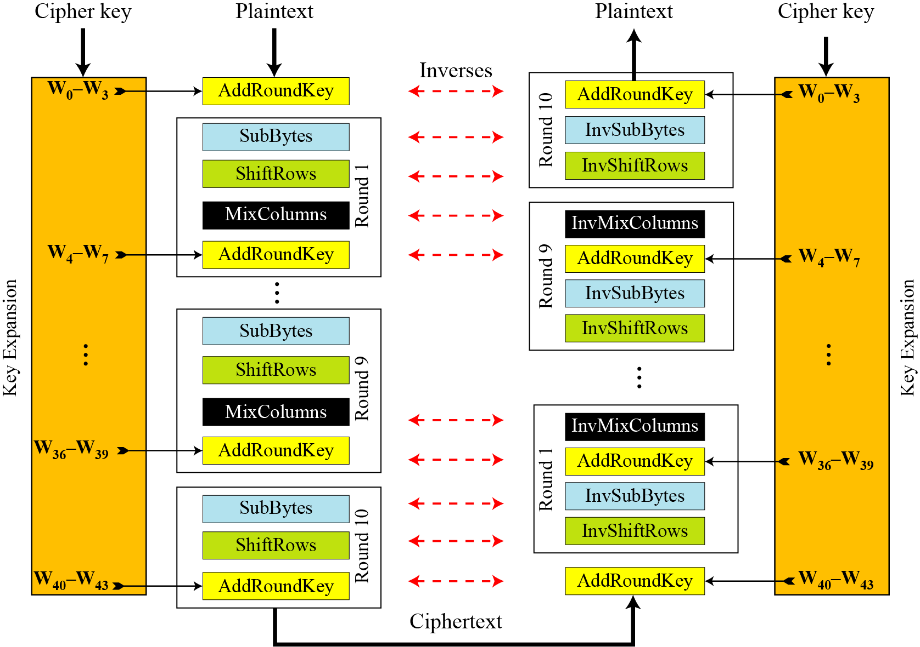
AES Overall Structure

Slide 51
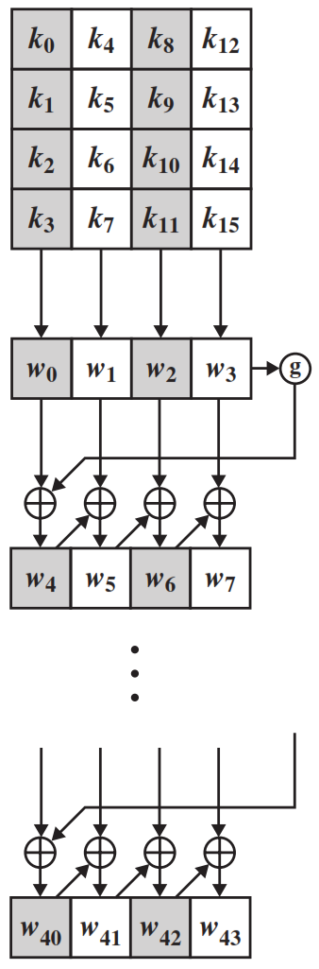
AES Key Expansion
The AES key expansion algorithm takes as input a four-word (16-byte) key and produces a linear array of 44 words (176 bytes).
Each added word w[i] depends on the immediately preceding word, w[i - 1].
In three out of four cases, a simple XOR is used.

Slide 52
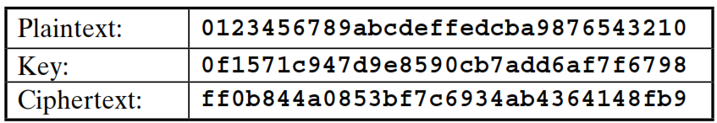
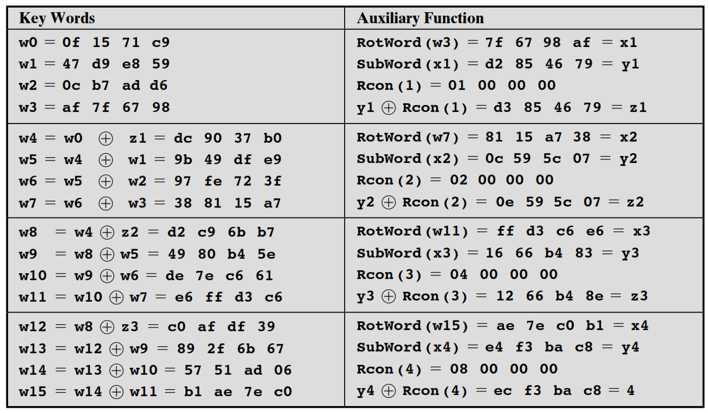
Key Expansion Example

Slide 53
Implementation Aspects
can efficiently implement on 8-bit CPU
byte substitution works on bytes using a table of 256 entries
shift rows is simple byte shift
add round key works on byte XOR’s
mix columns requires matrix multiply in GF(2⁸) which works on byte values, can be simplified to use table lookups & byte XOR’s
Notes:
The Rijndael proposal [DAEM99] provides some suggestions for efficient implementation on 8- bit processors, typical for current smart cards, and on 32-bit processors, typical for PCs.
AES can be implemented very efficiently on an 8-bit processor.
AddRoundKey is a bytewise XOR operation.
ShiftRows is a simple byte shifting operation.
SubBytes operates at the byte level and only requires a lookup of a 256 byte table S.
MixColumns (matrix multiply) can be implemented as byte XOR’s & table lookups with a 2nd 256 byte table X2, using the formulae shown in Stallings equation 5.9.

Slide 54
Implementation Aspects
can efficiently implement on 32-bit CPU
redefine steps to use 32-bit words
can precompute 4 tables of 256-words
then each column in each round can be computed using 4 table lookups + 4 XORs
at a cost of 4Kb to store tables
designers believe this very efficient implementation was a key factor in its selection as the AES cipher
Notes:
AES can also be very efficiently implemented on an 32-bit processor, by rewriting the stage transformation to use 4 table lookups & 4 XOR’s per column of state. These tables can be computed in advance using the formulae shown in the text, and need 4Kb to store.
The developers of Rijndael believe that this compact, efficient implementation was probably one of the most important factors in the selection of Rijndael for AES.

Slide 55
Summary
have considered:
the AES selection process
the details of Rijndael – the AES cipher
looked at the steps in each round
the key expansion
implementation aspects
Notes:
Chapter 5 summary.

Slide 56

Multiple encryptions and triple DES

Slide 57
Outline
Multiple encryption and triple DES
Electronic Code Book Mode
Cipher Block Chaining Mode
Cipher Feedback Mode
Output Feedback Mode
Counter Mode
Notes:
X.800 and RFC 2828
International Telecommunication Union (ITU)

Slide 58
Chapter 6 – Block Cipher Operation
Many savages at the present day regard their names as vital parts of themselves, and therefore take great pains to conceal their real names, lest these should give to evil-disposed persons a handle by which to injure their owners.
— The Golden Bough, Sir James George Frazer
Notes:
Opening quote.

Slide 59
Multiple Encryption & DES
clear a replacement for DES was needed
theoretical attacks that can break it
demonstrated exhaustive key search attacks
AES is a new cipher alternative
prior to this alternative was to use multiple encryption with DES implementations
Triple-DES is the chosen form
Notes:
Given the potential vulnerability of DES to a brute-force attack,there has been considerable interest in finding an alternative. One approach is to design a completely new algorithm, of which AES is a prime example. Another alternative, which would preserve the existing investment in software and equipment, is to use multiple encryption with DES and multiple keys. We examine the widely accepted triple DES (3DES) approach.

Slide 60
Double-DES?
could use 2 DES encrypts on each block
C = E_{K2}(E_{K1}(P))
issue of reduction to single stage
and have “meet-in-the-middle” attack
works whenever use a cipher twice
since X = E_{K1}(P) = D_{K2}(C)
attack by encrypting P with all keys and store
then decrypt C with keys and match X value
can show takes O(2⁵⁶) steps
Notes:
The simplest form of multiple encryption has two encryption stages and two keys - Double-DES.
Have concern that there might be a single key that is equivalent to using 2 keys as above, not likely but only finally proved as impossible in 1992.
More seriously have the “meet-in-the-middle” attack, first described by Diffie in 1977. It is a known plaintext attack (ie have know pair (P,C), and attempts to find by trial-and-error a value X in the “middle” of the double-DES encryption of this pair, and chances of this are much better at O(2^56) than exhaustive search at O(2^112).

Slide 61
Triple-DES with Two-Keys
hence must use 3 encryptions
would seem to need 3 distinct keys
but can use 2 keys with E-D-E sequence
C = E_{K1}(D_{K2}(E_{K1}(P)))
nb encrypt & decrypt equivalent in security
if K1=K2 then can work with single DES
standardized in ANSI X9.17 & ISO8732
no current known practical attacks
several proposed impractical attacks might become basis of future attacks
Notes:
Triple-DES with two keys is a popular alternative to single-DES, but suffers from being 3 times slower to run. The use of encryption & decryption stages are equivalent, but the chosen structure allows for compatibility with single-DES implementations. 3DES with two keys is a relatively popular alternative to DES and has been adopted for use in the key management standards ANS X9.17 and ISO 8732. Currently, there are no practical cryptanalytic attacks on 3DES. Coppersmith notes that the cost of a brute-force key search on 3DES is on the order of 2^112 (=5*10^33) and estimates that the cost of differential cryptanalysis suffers an exponential growth, compared to single DES, exceeding 10^52.
There are several proposed attacks on 3DES that, although not currently practical, give a flavor for the types of attacks that have been considered and that could form the basis for more successful future attacks. See text for details.

Slide 62
Triple-DES with Three-Keys
although are no practical attacks on two-key Triple-DES have some indications
can use Triple-DES with Three-Keys to avoid even these
C = E_{K3}(D_{K2}(E_{K1}(P)))
has been adopted by some Internet applications, eg PGP, S/MIME
Notes:
Although the attacks currently known appear impractical, anyone using two-key 3DES may feel some concern. Thus, many researchers now feel that three-key 3DES is the preferred alternative. Three-key 3DES has an effective key length of 168 bits and is defined as shown. A number of Internet-based applications have adopted three-key 3DES, including PGP and S/MIME.

Slide 63
Modes of Operation
block ciphers encrypt fixed size blocks
eg. DES encrypts 64-bit blocks with 56-bit key
need some way to en/decrypt arbitrary amounts of data in practise
NIST SP 800-38A defines 5 modes
have block and stream modes
to cover a wide variety of applications
can be used with any block cipher
Notes:
DES (or any block cipher) forms a basic building block, which en/decrypts a fixed sized block of data. However to use these in practise, we usually need to handle arbitrary amounts of data, which may be available in advance (in which case a block mode is appropriate), and may only be available a bit/byte at a time (in which case a stream mode is used). To apply a block cipher in a variety of applications, five "modes of operation" have been defined by NIST (SP 800-38A). In essence, a mode of operation is a technique for enhancing the effect of a cryptographic algorithm or adapting the algorithm for an application, such as applying a block cipher to a sequence of data blocks or a data stream. The five modes are intended to cover a wide variety of applications of encryption for which a block cipher could be used. These modes are intended for use with any symmetric block cipher, including triple DES and AES. .

Slide 64
Block Cipher Modes of Operations
To apply a block cipher in a variety of applications, five "modes of operation" have been defined.
The five modes are intended to cover a wide variety of applications of encryption for which a block cipher could be used.
These modes are intended for use with any symmetric block cipher, including triple DES and AES.
Electronic Code Book (ECB)
Cipher Block Chaining (CBC)
Cipher Feedback (CFB)
Output Feedback (OFB)
Counter (CTR)

Slide 65
1. Electronic Code Book (ECB)
In ECB Mode Plaintext handled one block at a time and each block of plaintext is encrypted using the same key.
The term codebook is used because, for a given key, there is a unique ciphertext for every b-bit block of plaintext.

Slide 66
1. ECB Encryption & Decryption
P₁
P₂
P_{N}
64-bit
64-bit
64-bit
K
K
…
K
Encrypt
Encrypt
Encrypt
64-bit
64-bit
64-bit
C₁
C₂
C_{N}
C₁
C₂
C_{N}
64-bit
64-bit
64-bit
K
K
…
K
Decrypt
Decrypt
Decrypt
64-bit
64-bit
64-bit
P₁
P₂
P_{N}

Slide 67
Electronic Code Book - Cont…
Strength: it’s simple.
Weakness:
Repetitive information contained in the plaintext may show in the ciphertext, if aligned with blocks.
If the message has repetitive elements with a period of repetition a multiple of b bits, then these elements can be identified by the analyst.
Typical application:
Secure transmission of short pieces of information (e.g. a temporary encryption key)

Slide 68
2. Cipher Block Chaining (CBC)
CBC is a technique in which the same plaintext block, if repeated, produces different ciphertext blocks.
In this scheme, the input to the encryption algorithm is the XOR of the current plaintext block and the preceding ciphertext block; the same key is used for each block.
To produce the first block of ciphertext, an initialization vector (IV) is XORed with the first block of plaintext.
On decryption, the IV is XORed with the output of the decryption algorithm to recover the first block of plaintext.

Slide 69
2. CBC - Encryption & Decryption
P₁
P₂
P_{N}
IV
C_{N-1}
K
K
…
K
Encrypt
Encrypt
Encrypt
C₁
C₂
C_{N}
C₁
C₂
C_{N}
K
K
…
K
Decrypt
Decrypt
Decrypt
IV
C_{N-1}
P₁
P₂
P_{N}

Slide 70
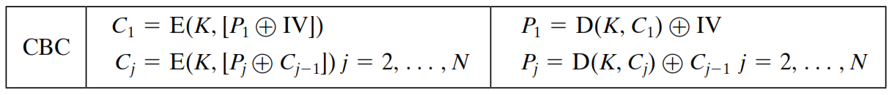
2. Cipher Block Chaining (CBC) – Cont…
Strength: because of the chaining mechanism of CBC, it is an appropriate mode for encrypting messages of length greater than b bits
Typical application:
General-purpose block oriented transmission
Authentication

Slide 71
3. Cipher Feedback Mode (CFB)
For AES, DES, or any block cipher, encryption is performed on a block of b bits. In DES, b = 64 and in AES, b = 128.
However, it is possible to convert a block cipher into a stream cipher, using cipher feedback (CFB) mode, output feedback (OFB) mode, and counter (CTR) mode.
A stream cipher eliminates the need to pad a message to be an integral number of blocks.

Slide 72
3. CFB Encryption
C_{N-1}
IV
Shift register b-s bits | s bits
Shift register b-s bits | s bits
K
K
K
Encrypt
Encrypt
Encrypt
…
Select s bits
Discard b-s bits
Select s bits
Discard b-s bits
Select s bits
Discard b-s bits
S bits
S bits
S bits
P₁
P₂
P_{N}
C₁
C₂
C_{N}
S bits
S bits
S bits
Notes:
Unit od transmission is 8 bits
Common value of s=8

Slide 73
3. CFB Decryption
C_{N-1}
IV
Shift register b-s bits | s bits
Shift register b-s bits | s bits
K
K
K
Encrypt
Encrypt
Encrypt
…
Select s bits
Discard b-s bits
Select s bits
Discard b-s bits
Select s bits
Discard b-s bits
C₁
C₂
C_{N}
S bits
S bits
S bits
P₁
P₂
P_{N}
S bits
S bits
S bits
Notes:
Unit od transmission is 8 bits
Common value of s=8

Slide 74
CFB Mode
The input to the encryption function is a b-bit shift register that is initially set to some initialization vector (IV).
The leftmost (most significant) s bits of the output of the encryption function are XORed with the first segment of plaintext P1 to produce the first unit of ciphertext C1 , which is then transmitted.
In addition, the contents of the shift register are shifted left by s bits, and C1 is placed in the rightmost (least significant) s bits of the shift register.
For decryption, the same scheme is used, except that the received ciphertext unit is XORed with the output of the encryption function to produce the plaintext unit.

Slide 75
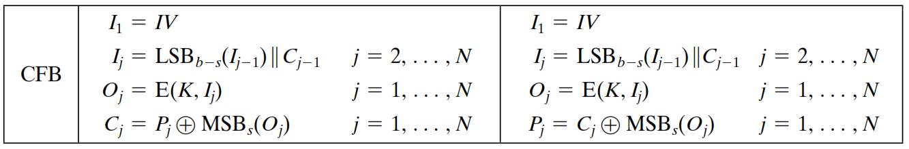
CFB Mode – Cont…

Slide 76
4. Output Feedback Mode (OFB)
The output feedback (OFB) mode is similar in structure to that of CFB.
For OFB, the output of the encryption function is fed back to become the input for encrypting the next block of plaintext.
In CFB, the output of the XOR unit is fed back to become input for encrypting the next block.
The other difference is that the OFB mode operates on full blocks of plaintext and ciphertext, whereas CFB operates on an s-bit subset.
Nonce: A time-varying value that has at most a negligible chance of repeating, for example, a random value that is generated anew for each use, a timestamp, a sequence number, or some combination of these.

Slide 77
4. OFB Encryption
Nonce
K
K
…
K
Encrypt
Encrypt
Encrypt
P₁
P₂
P_{N}
C₁
C₂
C_{N}

Slide 78
4. OFB Decryption
Nonce
K
K
…
K
Encrypt
Encrypt
Encrypt
C₁
C₂
C_{N}
P₁
P₂
P_{N}

Slide 79
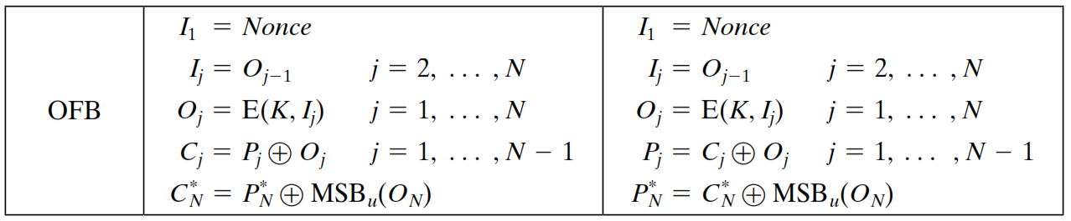
OFB Mode
Each bit in the ciphertext is independent of the previous bit or bits.
This avoids error propagation
Pre-compute of forward cipher is possible

Slide 80
5. Counter Mode (CTR)
Counter (CTR) mode has increased recently with applications to ATM (asynchronous transfer mode) network security and IP sec (IP security).
A counter equal to the plaintext block size is used.
The counter value must be different for each plaintext block that is encrypted.
Typically, the counter is initialized to some value and then incremented by 1 for each subsequent block

Slide 81
5. CTR Encryption
Counter 1
Counter 2
Counter N
K
K
…
K
Encrypt
Encrypt
Encrypt
P₁
P₂
P_{N}
C₁
C₂
C_{N}

Slide 82
4. CTR Decryption
Counter 1
Counter 2
Counter N
K
K
…
K
Encrypt
Encrypt
Encrypt
C₁
C₂
C_{N}
P₁
P₂
P_{N}

Slide 83
Advantages of the CTR Mode
Strengths:
Needs only the encryption algorithm
Random access to encrypted data blocks
blocks can be processed (encrypted or decrypted) in parallel
Simple; fast encryption/decryption
Counter must be
Must be unknown and unpredictable
pseudo-randomness in the key stream is a goal

Slide 84
Summary of all modes
Operation Mode | Description | Type of Result
ECB | Each n-bit block is encrypted independently with same key | Block Cipher
CBC | Same as ECB, but each block is XORed with previous cipher text | Block Cipher
CFB | Each s-bit block is XORed with s-bit key which is part of previous cipher text | Stream Cipher
OFB | Same as CFB, but the shift register is updated by the previous s-bit key | Stream Cipher
CTR | Same as OFB, but a counter is used instead of nonce | Stream Cipher

Slide 85
Multiple Encryption
Given the potential vulnerability of DES to a brute-force attack, there has been considerable interest in finding an alternative.
One approach is to design a completely new algorithm, of which AES is a prime example.
Another alternative, which would preserve the existing investment in software and equipment, is to use multiple encryption with DES and multiple keys.

Slide 86
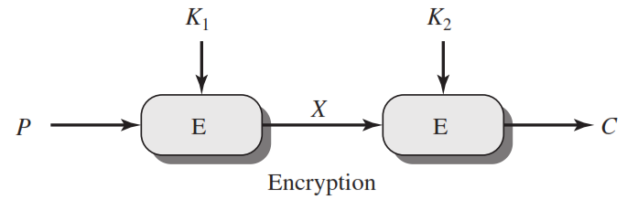
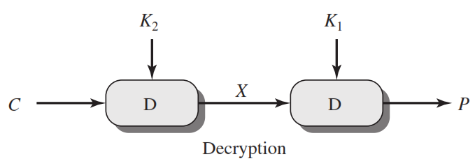
Double DES
C=E(K₂,E(K₁, P))
X = E(K₁, P) = D(K₂, C)
P=D(K₁,D(K₂, C))

Slide 87
Meet in the Middle Attack
This attack involves encryption from one end, decryption from the other and matching the results in the middle.
Suppose cryptanalyst knows P and corresponding C.
Now, the aim is to obtain the values of K₁ and K₂.

Slide 88
Meet in the Middle Attack Step-1
For all possible values (2⁵⁶) of key K1, the cryptanalyst would encrypt the P by performing E(K1,P).
The cryptanalyst would store output in a table.
Possible Keys
(Key = K1)
00
01
10
11
P
Table of Cipher Text
Encrypt
Cryptanalyst encryption operation

Slide 89
Meet in the Middle Attack Step-2
Cryptanalyst decrypt the known C with all possible values of K2.
In each case cryptanalyst will compare the resulting value with the all values in the table of ciphertext.
Possible Keys
(Key = K2)
00
01
10
11
Table of Cipher Text
C
Decrypt
For each result do a table look up
Cryptanalyst decryption operation

Slide 90
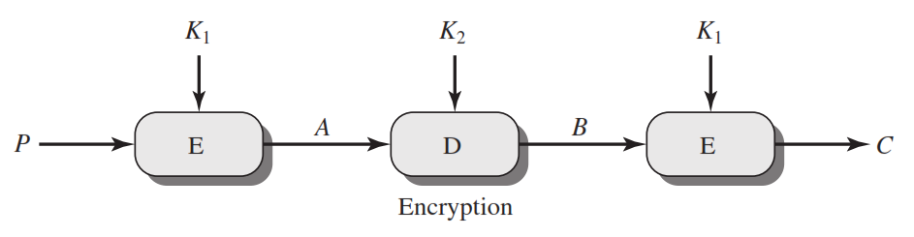
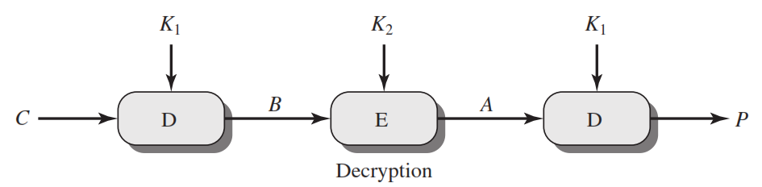
Triple DES
C=E(K₁,D(K₂, E(K₁,P)))
P=D(K₁,E(K₂, D(K₁,C)))

Slide 91
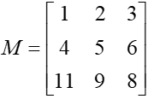

N-gram Hill cipher
Lester Hill, 1929. Not used much, but is historically significant: first time linear algebra used in crypto
Use an n x n matrix M. Encrypt by breaking plaintext into blocks of length n (padding with x’s if needed) and multiplying each by M (mod 26).
Example: Encrypt “hereissomeonetoencrypt” using M
her eis som eon eto enc ryp txx
(7, 4, 17) (4, 8, 18) … (19, 23, 23)
(2, 5, 25) (0, 2, 22) … (0, 22, 15)
cfz acw yga vns ave anc sdd awp
“CFZACWYGAVNSAVEANCSDDAWP”

Slide 92
Decrypting
Reverse the process, multiplying each block by M inverse (mod n)
Theorem: If a matrix M is invertible mod n, then gcd(det(M), n) = 1

Slide 93


